Slide 1
ANTI-MONEY LAUNDERING SYSTEM
DATA PROCRASTINATORS

Slide 2
TABLE OF CONTENTS
01
02
03
Project Overview
Bus
Matrix
Dimension
Modelling
04
05
06
Schema
Business Processes
BI & Actionable Insights

Slide 3
PROJECT OVERVIEW
Goal
Implement an AML data warehouse to detect suspicious transactions and ensure regulatory compliance
Milestone
Business process identification, star schema design, ETL implementation, and data load
Key Features
Suspicious activity reporting (SAR), transaction flagging, and regulatory compliance

Slide 4
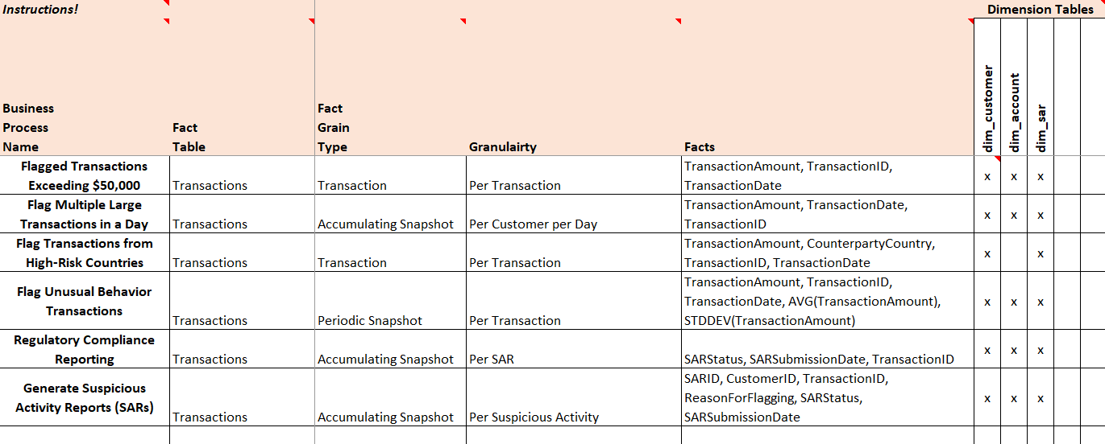
BUS MATRIX

Slide 5
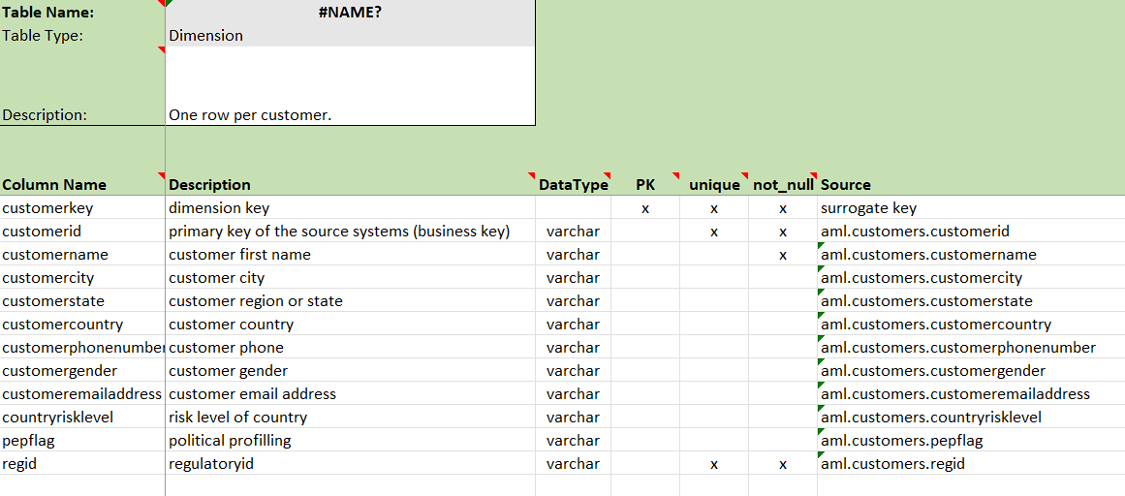
DIMENSIONAL MODELING

Slide 6
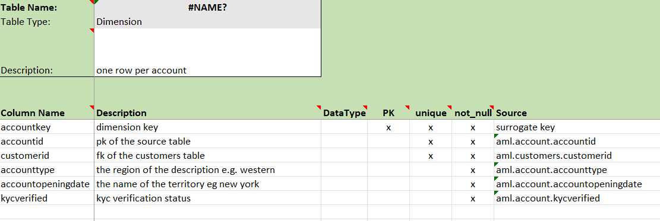
DIMENSIONAL MODELING

Slide 7
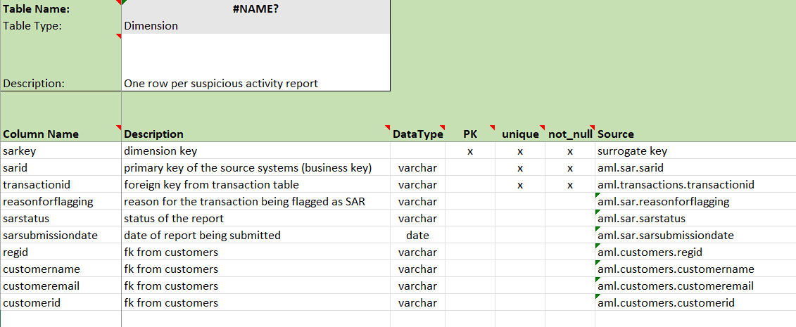
DIMENSIONAL MODELING

Slide 8
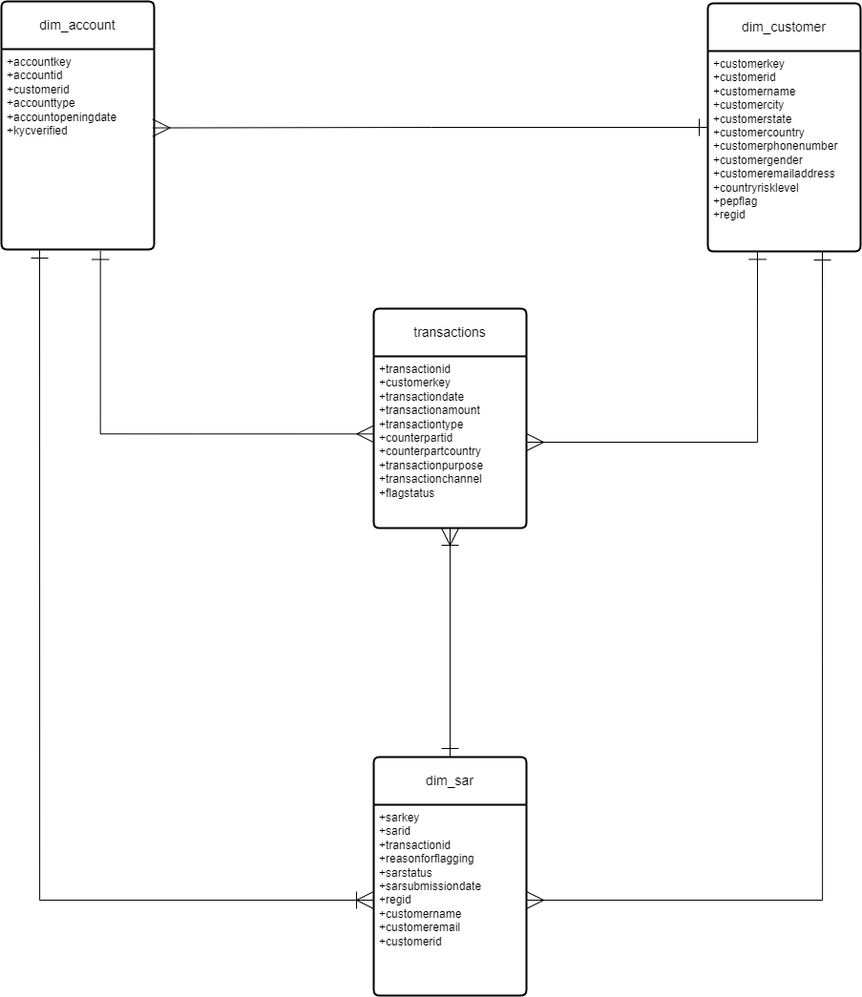
SCHEMA

Slide 9
FLAG TRANSACTIONS OF HIGH AMOUNT
Description: Transactions exceeding $50,000 are flagged for suspicious activity.
Fact Table: Transactions
Dimension Tables: Customer, Account, SAR
Facts: TransactionAmount, TransactionDate, TransactionID

Slide 10
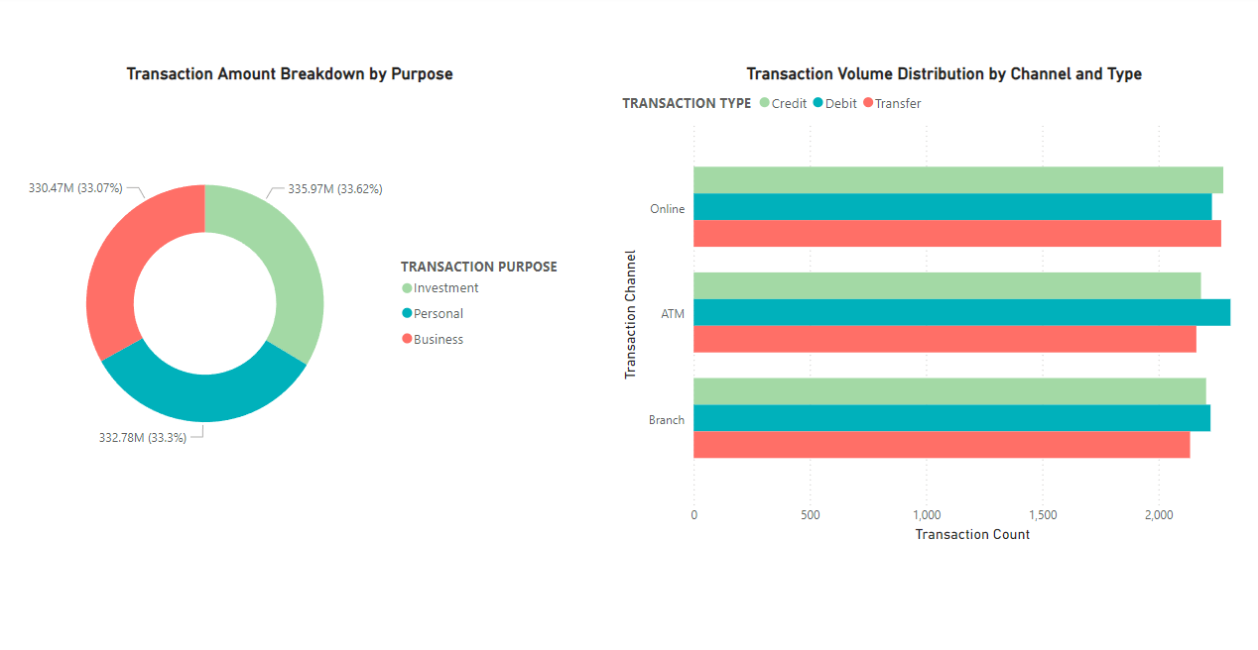
ANALYTICS 1

Slide 11
FLAG MULTIPLE TRANSACTIONS
Description: Flags customers with more than two large transactions within a day.
Fact Table: Transactions
Dimension Tables: Customer, Account, SAR
Facts: TransactionAmount, TransactionDate, TransactionID

Slide 12
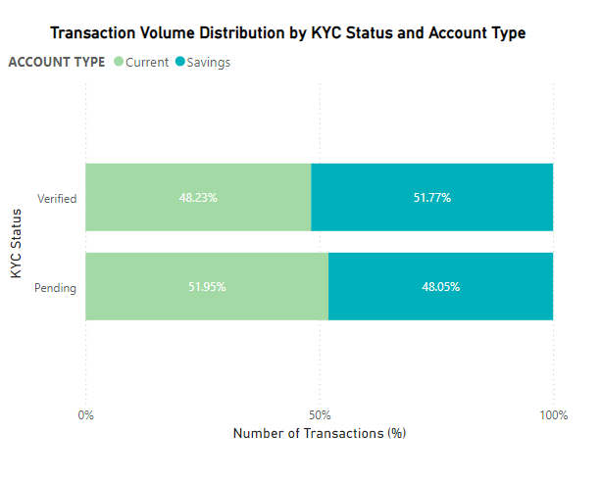
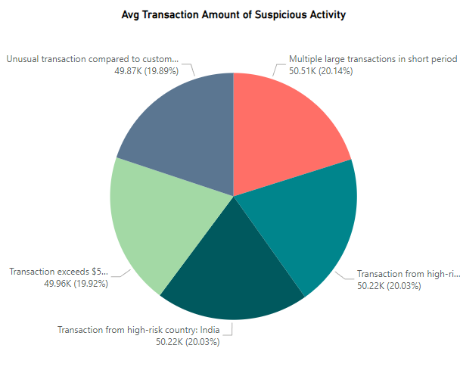
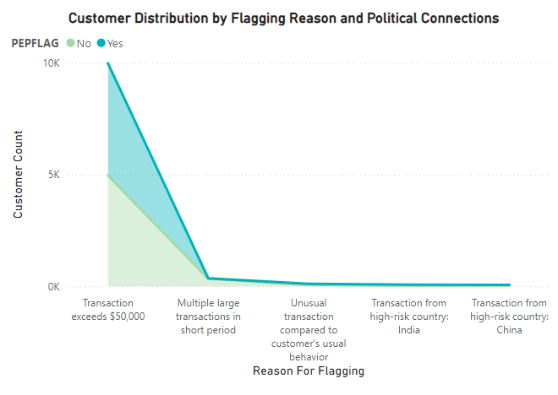
ANALYTICS 2

Slide 13
FLAG TRANSACTIONS FROM HIGH-RISK COUNTRIES
Description: Flags transactions originating from high-risk countries.
Fact Table: Transactions
Dimension Tables: Customer, SAR
Facts: TransactionAmount, CounterpartyCountry, TransactionDate

Slide 14
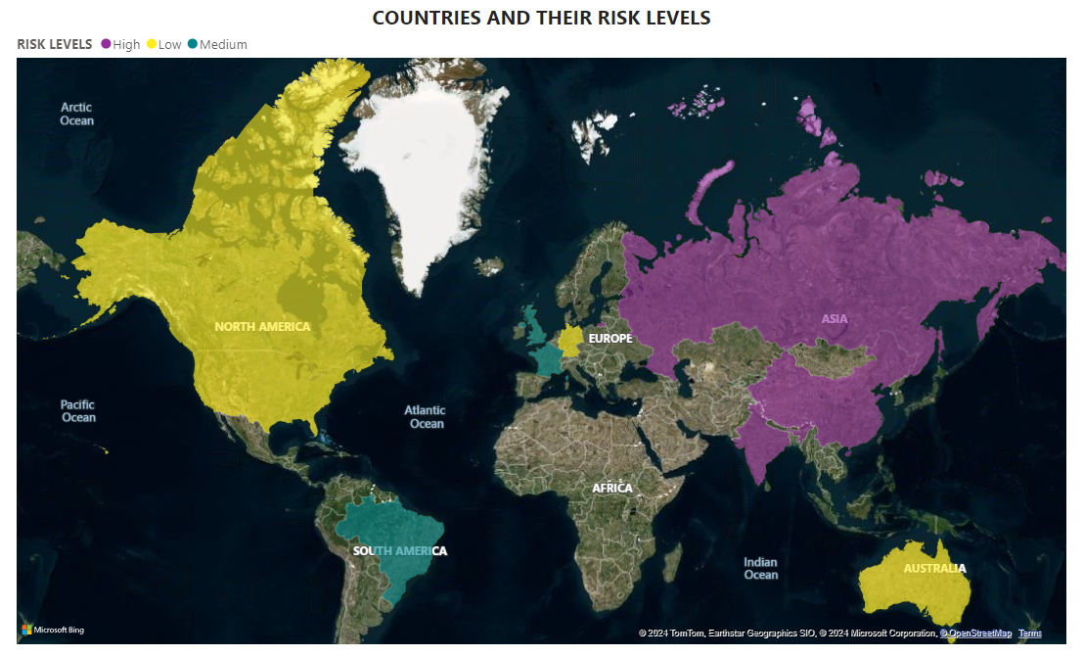
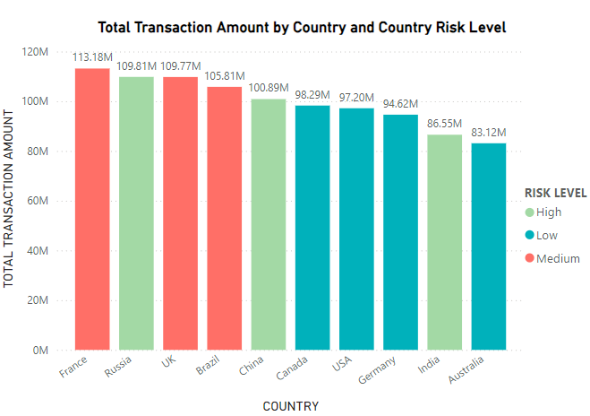
ANALYTICS 3

Slide 15
FLAG UNUSUAL BEHAVIOUR TRANSACTIONS
Description: Flags transactions that deviate significantly from a customer’s usual behavior.
Fact Table: Transactions
Dimension Tables: Customer, Account, SAR
Facts: TransactionAmount, TransactionID, TransactionDate, AVG(TransactionAmount), STDDEV(TransactionAmount)

Slide 16
REGULATORY COMPLIANCE REPORTING
Description: Updates the SAR status to 'Submitted' after regulatory compliance.
Fact Table: Transactions
Dimension Tables: Customer, SAR
Facts: SARStatus, SARSubmissionDate, TransactionID

Slide 17
MOST IMPORTANTLY…
OUR PROJECT EXHIBITS THE 4 CHARACTERISTICS OF A DATA WAREHOUSE
Subject-Oriented: Focuses on transactions and suspicious activities.
Integrated: Consolidates data from multiple sources (e.g., transactions, customer info, SAR).
Time-Variant: Tracks historical data for each transaction
Non-Volatile: Data is stored for long-term analysis and reporting

Slide 18
BUSINESS INTELLIGENCE & ACTIONABLES INSIGHTS
Our dashboard provides:
Meaningful Insights: The ability to detect fraud, money laundering, and non-compliant activities.
Actionable Reporting: Alerts to compliance officers for immediate action.

Slide 19
THANK YOU

Slide 20
WAYFORWARD
Transform
Business Rules Application
Flag transactions from high-risk countries
Flag multiple large transactions within a short period
Flag transactions involving high-risk customers (based on high-risk score, e.g., 8 or above)
Load
Insert data into dimension tables first, then load
Validate foreign key constrains t ensure data integrity
Automation,Visualization and Reporting

